Slide 1


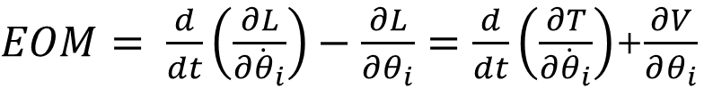

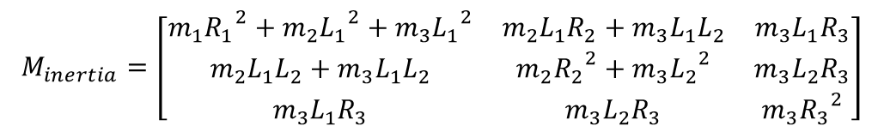



April 6th Updates:
Last time when calculate EOM:
$EOM= \frac{d}{dt}\left(\frac{∂L}{∂{\dot{θ}}_{i}}\right)−\frac{∂L}{∂θ_{i}}=\frac{d}{dt}\left(\frac{∂T}{∂{\dot{θ}}_{i}}\right)$+$\frac{∂V}{∂θ_{i}}$
$$EOM=M_{inertia}∗ {\ddot{θ}}_{i}+{Grav}_{i}$$
$T= \frac{1}{2}m_{1}{({\dot{θ}}_{1}∙ R_{1}) }^{2}$+ $\frac{1}{2}m_{2}{({\dot{θ}}_{1}∙ L_{1}+{\dot{θ}}_{2}∙ R_{2}) }^{2}$+ $\frac{1}{2}m_{3}{({\dot{θ}}_{1}∙ L_{1}+{\dot{θ}}_{2}∙ L_{2}+{\dot{θ}}_{3}∙ R_{3}) }^{2}$
$V= {[m}_{1}g∙M_{1}R_{1}+m_{2}g∙{(M}_{1}L_{1}+{M_{1}M}_{2}R_{2}$)+$m_{3}g∙{(M}_{1}L_{1}+{{M_{1}M}_{2}L_{2}+{M_{1}M}_{2}M}_{3}R_{3}\text{)}\text{]}$
$$\text{∗}\left[\begin{matrix}0 & 1 & 0\end{matrix}\right]$$
We define:
$$M_{inertia}=\left[\begin{matrix}m_{1}{R_{1}}^{2}+m_{2}{L_{1}}^{2}+m_{3}{L_{1}}^{2} & m_{2}L_{1}R_{2}+m_{3}L_{1}L_{2} & m_{3}L_{1}R_{3} \\ m_{2}L_{1}L_{2}+m_{3}L_{1}L_{2} & m_{2}{R_{2}}^{2}+m_{3}{L_{2}}^{2} & m_{3}L_{2}R_{3} \\ m_{3}L_{1}R_{3} & m_{3}L_{2}R_{3} & m_{3}{R_{3}}^{2}\end{matrix}\right]$$
$R_{1}$ Femur COM to Hip distance
$L_{1}$ Femur Length (Hip to knee distance)
$R_{2}$ Tibia COM to Knee distance
$${Grav}_{i}= \left[\begin{matrix}−m_{1}g{\dot{M}}_{1}R_{1}−m_{2}g\left({\dot{M}}_{1}R_{1}−{\dot{M}}_{1}L_{1}+{\dot{M}}_{1}M_{2}R_{2}\right)−m_{3}g({\dot{M}}_{1}R_{1}−{\dot{M}}_{1}L_{1}+{\dot{M}}_{1}M_{2}R_{2}−{\dot{M}}_{1}M_{2}L_{2}+{\dot{M}}_{1}M_{2}M_{3}R_{3}) \\ −m_{2}g{M_{1}\dot{M}}_{2}R_{2}−m_{3}g({{{M_{1}\dot{M}}_{2}R_{2}−M}_{1}\dot{M}}_{2}L_{2}+{M_{1}\dot{M}}_{2}M_{3}R_{3}) \\ −m_{3}g{{M_{1}M}_{2}\dot{M}}_{3}R_{3}\end{matrix}\right]$$
$L_{2}$ Tibia Length (knee to ankle distance)
$R_{2}$ Foot COM to ankle distance

Slide 2

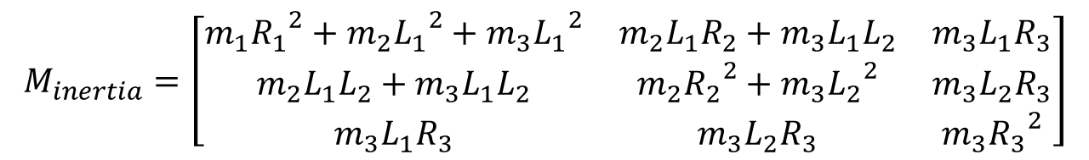
After used Mathematica to check, found out couple problems:
Should be $R_{2}$
$$M_{inertia}=\left[\begin{matrix}m_{1}{R_{1}}^{2}+m_{2}{L_{1}}^{2}+m_{3}{L_{1}}^{2} & m_{2}L_{1}R_{2}+m_{3}L_{1}L_{2} & m_{3}L_{1}R_{3} \\ m_{2}L_{1}L_{2}+m_{3}L_{1}L_{2} & m_{2}{R_{2}}^{2}+m_{3}{L_{2}}^{2} & m_{3}L_{2}R_{3} \\ m_{3}L_{1}R_{3} & m_{3}L_{2}R_{3} & m_{3}{R_{3}}^{2}\end{matrix}\right]$$
(Blue line before fix, Red line after fix)

Slide 3







Also Fix a rotation factor in gravitational term in hip torque profile:
(Blue line before fix, Red line after fix)
In this method, we define T as:
$R_{1}$ Femur COM to Hip distance
$T= \frac{1}{2}m_{1}{({\dot{θ}}_{1}∙ R_{1}) }^{2}$+ $\frac{1}{2}m_{1}{({\dot{θ}}_{1}∙ L_{1}+{\dot{θ}}_{2}∙ R_{2}) }^{2}$+ $\frac{1}{2}m_{1}{({\dot{θ}}_{1}∙ L_{1}+{\dot{θ}}_{2}∙ L_{2}+{\dot{θ}}_{3}∙ R_{3}) }^{2}$
$L_{1}$ Femur Length (Hip to knee distance)
$R_{2}$ Tibia COM to Knee distance
Where Rs and Ls are constant length, this leads to
$L_{2}$ Tibia Length (knee to ankle distance)
$EOM= \frac{d}{dt}\left(\frac{∂L}{∂{\dot{θ}}_{i}}\right)−\frac{∂L}{∂θ_{i}}=\frac{d}{dt}\left(\frac{∂T}{∂{\dot{θ}}_{i}}\right)$+$\frac{∂V}{∂θ_{i}}$
Which missing$\frac{∂T}{∂θ_{i}}$ terms
$R_{2}$ Foot COM to ankle distance

Slide 4
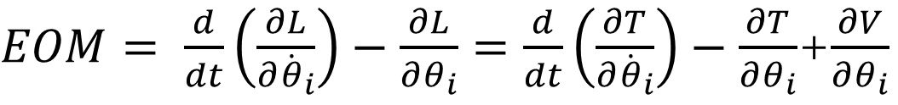
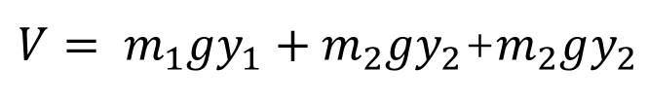
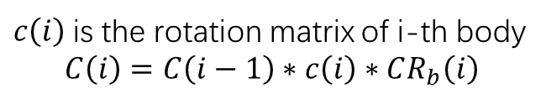

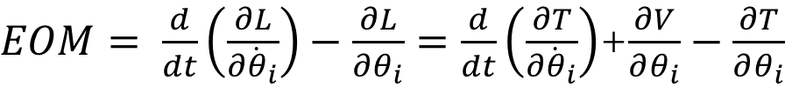
EOM method 2:
$T= \frac{1}{2}m_{1}({{\dot{x}}_{1}}^{2}+{{\dot{y}}_{1}}^{2}+{{\dot{z}}_{1}}^{2})$+$\frac{1}{2}m_{2}({{\dot{x}}_{2}}^{2}+{{\dot{y}}_{2}}^{2}+{{\dot{z}}_{2}}^{2})$+$\frac{1}{2}m_{3}({{\dot{x}}_{3}}^{2}+{{\dot{y}}_{3}}^{2}+{{\dot{z}}_{3}}^{2})$
$V= m_{1}gy_{1}+m_{2}gy_{2}$+$m_{2}gy_{2}$
Where x, y, z are world position of body COM
$EOM= \frac{d}{dt}\left(\frac{∂L}{∂{\dot{θ}}_{i}}\right)−\frac{∂L}{∂θ_{i}}=\frac{d}{dt}\left(\frac{∂T}{∂{\dot{θ}}_{i}}\right)$+$\frac{∂V}{∂θ_{i}}−\frac{∂T}{∂θ_{i}}$
Where $\left[\begin{matrix}x_{0} \\ y_{0} \\ z_{0}\end{matrix}\right]$ =$\left[\begin{matrix}0 \\ 0 \\ 0\end{matrix}\right]$ World position of pelvis
$\left[\begin{matrix}x_{i} \\ y_{i} \\ z_{i}\end{matrix}\right]$= $\left[\begin{matrix}x_{i−1} \\ y_{i−1} \\ z_{i−1}\end{matrix}\right]+C\left(i\right)∗P_{b}\left(i+1\right)+C\left(i\right)∗\left[I−c\left(i+1\right)\right]∗CR_{b}\left(i+1\right)∗P_{j}(i+1)$
$c\left(i\right)$is the rotation matrix of i-th body
$$C\left(i\right)=C\left(i−1\right)∗c\left(i\right)∗CR_{b}\left(i\right)$$
$EOM= \frac{d}{dt}\left(\frac{∂L}{∂{\dot{θ}}_{i}}\right)−\frac{∂L}{∂θ_{i}}=\frac{d}{dt}\left(\frac{∂T}{∂{\dot{θ}}_{i}}\right)−\frac{∂T}{∂θ_{i}}$+$\frac{∂V}{∂θ_{i}}$
$${EOM=M}_{inertia1}∗ {\ddot{θ}}_{i}+M_{inertia2}∗{\dot{θ}}_{i}{\dot{θ}}_{j}{−M}_{Moment}∗{\dot{θ}}_{i}{\dot{θ}}_{j}+{Grav}_{i}$$

Slide 5


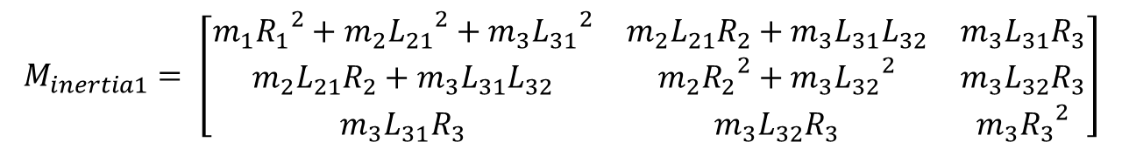

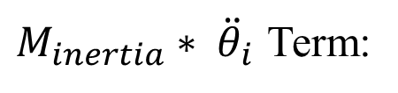
$M_{inertia}∗ {\ddot{θ}}_{i}$ Term:
$$M_{inertia1}= \left[\begin{matrix}m_{1}{R_{1}}^{2}+m_{2}{L_{21}}^{2}+m_{3}{L_{31}}^{2} & m_{2}L_{21}R_{2}+m_{3}L_{31}L_{32} & m_{3}L_{31}R_{3} \\ m_{2}L_{21}R_{2}+m_{3}L_{31}L_{32} & m_{2}{R_{2}}^{2}+m_{3}{L_{32}}^{2} & m_{3}L_{32}R_{3} \\ m_{3}L_{31}R_{3} & m_{3}L_{32}R_{3} & m_{3}{R_{3}}^{2}\end{matrix}\right]$$
Where Rs and Ls are position vectors:
$$R_{1}=−C\left(1\right)∗\grave{c}\left(2\right)∗CR_{b}\left(2\right){∗P}_{j}\left(2\right)$$
$L_{21}=C\left(1\right)∗\grave{c}\left(2\right)∗CR_{b}\left(2\right)$*(-$P_{j}\left(2\right)+P_{b}\left(3\right)+\left[I−c\left(3\right)\right]∗CR_{b}\left(3\right)∗P_{j}\left(3\right)$)
$$R_{2}=−C\left(2\right)∗\grave{c}\left(3\right)∗CR_{b}\left(3\right){∗P}_{j}\left(3\right)$$
$L_{31}=L_{21}+C\left(1\right)∗\grave{c}\left(2\right)∗CR_{b}\left(2\right)$*$c\left(3\right)$*$CR_{b}\left(3\right)$*($P_{b}\left(4\right)+\left[I−c\left(4\right)\right]∗CR_{b}\left(4\right)∗P_{j}\left(4\right)$)
$L_{32}=C\left(2\right)∗\grave{c}\left(3\right)∗CR_{b}\left(3\right)$*(-$P_{j}\left(3\right)+P_{b}\left(4\right)+\left[I−c\left(4\right)\right]∗CR_{b}\left(4\right)∗P_{j}\left(4\right)$)
$$R_{3}=−C\left(3\right)∗\grave{c}\left(4\right)∗CR_{b}\left(4\right){∗P}_{j}\left(4\right)$$
When compare with previous method, the Rs are exactly same (Take vector length of method 2 to compare)
However, Ls are not, which makes sense. We probably define the wrong L at method 1.

Slide 6
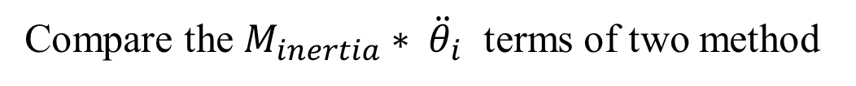
Compare the $M_{inertia}∗ {\ddot{θ}}_{i}$ terms of two method
(Red line is method2, Blue line is method1)

Slide 7
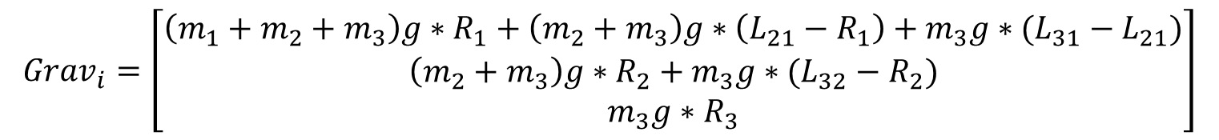
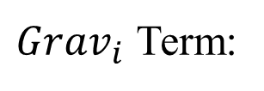
${Grav}_{i}$ Term:
$${Grav}_{i}=\left[\begin{matrix}\left(m_{1}+m_{2}+m_{3}\right)g∗R_{1}+\left(m_{2}+m_{3}\right)g∗\left(L_{21}−R_{1}\right)+m_{3}g∗(L_{31}−L_{21}) \\ \left(m_{2}+m_{3}\right)g∗R_{2}+m_{3}g∗(L_{32}−R_{2}) \\ m_{3}g∗R_{3}\end{matrix}\right]$$
(Red line is method2, Blue line is method1)

Slide 8
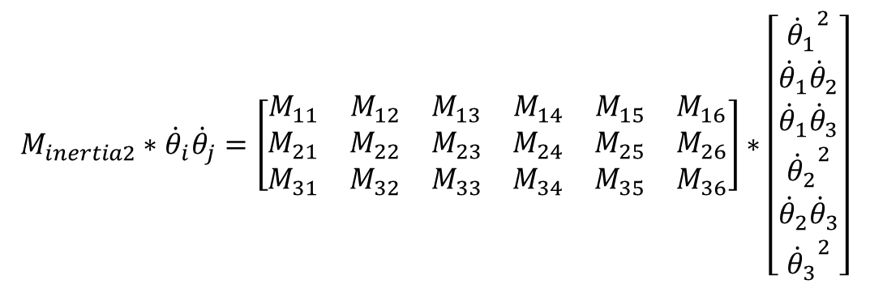
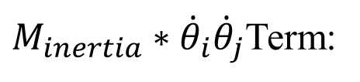
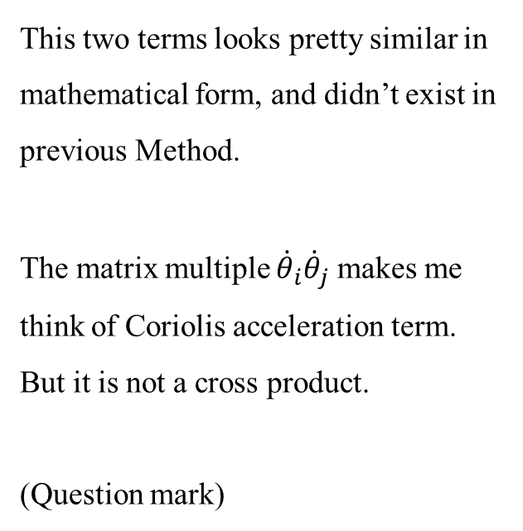
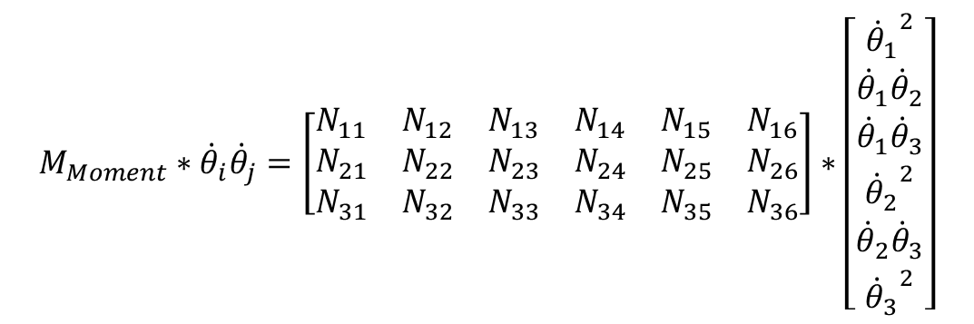
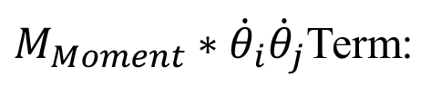
$M_{inertia}∗{\dot{θ}}_{i}{\dot{θ}}_{j}$Term:
$$M_{inertia2}∗{\dot{θ}}_{i}{\dot{θ}}_{j}=\left[\begin{matrix}\begin{matrix}M_{11} & M_{12} & M_{13} \\ M_{21} & M_{22} & M_{23} \\ M_{31} & M_{32} & M_{33}\end{matrix} & \begin{matrix}M_{14} & M_{15} & M_{16} \\ M_{24} & M_{25} & M_{26} \\ M_{34} & M_{35} & M_{36}\end{matrix}\end{matrix}\right]∗\left[\begin{matrix}\begin{matrix}{{\dot{θ}}_{1}}^{2} \\ {\dot{θ}}_{1}{\dot{θ}}_{2} \\ {\dot{θ}}_{1}{\dot{θ}}_{3}\end{matrix} \\ \begin{matrix}{{\dot{θ}}_{2}}^{2} \\ {\dot{θ}}_{2}{\dot{θ}}_{3} \\ {{\dot{θ}}_{3}}^{2}\end{matrix}\end{matrix}\right]$$
This two terms looks pretty similar in mathematical form, and didn’t exist in previous Method.
The matrix multiple ${\dot{θ}}_{i}{\dot{θ}}_{j}$ makes me think of Coriolis acceleration term.
But it is not a cross product.
(Question mark)
$M_{Moment}∗{\dot{θ}}_{i}{\dot{θ}}_{j}$Term:
$$M_{Moment}∗{\dot{θ}}_{i}{\dot{θ}}_{j}=\left[\begin{matrix}\begin{matrix}N_{11} & N_{12} & N_{13} \\ N_{21} & N_{22} & N_{23} \\ N_{31} & N_{32} & N_{33}\end{matrix} & \begin{matrix}N_{14} & N_{15} & N_{16} \\ N_{24} & N_{25} & N_{26} \\ N_{34} & N_{35} & N_{36}\end{matrix}\end{matrix}\right]∗\left[\begin{matrix}\begin{matrix}{{\dot{θ}}_{1}}^{2} \\ {\dot{θ}}_{1}{\dot{θ}}_{2} \\ {\dot{θ}}_{1}{\dot{θ}}_{3}\end{matrix} \\ \begin{matrix}{{\dot{θ}}_{2}}^{2} \\ {\dot{θ}}_{2}{\dot{θ}}_{3} \\ {{\dot{θ}}_{3}}^{2}\end{matrix}\end{matrix}\right]$$

Slide 9




Hidden slides, detail of the matrixes
$$M_{11}=2m_{1}R_{1}R_{11}+2m_{2}L_{21}L_{211}+2m_{3}L_{31}L_{311}$$
$M_{12}=2m_{2}L_{21}L_{212}+m_{2}L_{21}R_{21}+2m_{3}L_{31}L_{312}+m_{2}R_{2}L_{211}+m_{3}L_{31}L_{321}$+$m_{3}L_{32}L_{311}$
$$M_{13}=2m_{3}L_{31}L_{313}+m_{3}L_{31}R_{31}+m_{3}R_{3}L_{311}$$
$$M_{14}=m_{2}L_{21}R_{22}+m_{2}R_{2}L_{212}+m_{3}L_{31}L_{322}+m_{3}L_{32}L_{312}$$
$M_{15}=m_{3}L_{31}L_{323}+m_{3}L_{32}L_{313}+m_{3}L_{31}R_{32}$+$m_{3}R_{3}L_{312}$
$M_{16}= m_{3}L_{31}R_{33}$+$m_{3}R_{3}L_{313}$
$M_{21}=m_{2}L_{21}R_{21}+m_{2}R_{2}L_{211}+m_{3}L_{31}L_{321}$+$m_{3}L_{32}L_{311}$
$M_{22}=2m_{2}R_{2}R_{21}+m_{2}L_{21}R_{22}+m_{2}R_{2}L_{212}+m_{3}L_{31}L_{322}+m_{3}L_{32}L_{312}$+${2m}_{3}L_{32}L_{321}$
$$M_{23}=m_{3}L_{31}L_{323}+m_{3}L_{32}L_{313}+m_{3}L_{32}R_{31}+m_{3}R_{3}L_{321}$$
$$M_{24}={2m}_{2}R_{2}R_{22}+{2m}_{3}L_{32}L_{322}$$
$M_{25}={2m}_{3}L_{32}L_{323}+m_{3}L_{32}R_{32}$+$m_{3}R_{3}L_{322}$
$M_{26}= m_{3}L_{32}R_{33}$+$m_{3}R_{3}L_{323}$

Slide 10


















Hidden slides, detail of the matrixes
$$M_{31}=m_{3}L_{31}R_{31}+m_{3}R_{3}L_{311}$$
$$N_{21}=m_{2}L_{21}L_{212}+m_{3}L_{31}L_{312}$$
$M_{32}=m_{3}L_{31}R_{32}+m_{3}R_{3}L_{312}+m_{3}L_{32}R_{31}$+$m_{3}R_{3}L_{321}$
$N_{22}=m_{2}R_{2}L_{212}+m_{2}L_{21}R_{22}+m_{3}L_{31}L_{322}$+$m_{3}L_{32}L_{312}$
$$M_{33}=m_{3}L_{31}R_{33}+m_{3}R_{3}L_{313}+2m_{3}R_{3}R_{31}$$
$$N_{23}=m_{3}L_{31}R_{32}+m_{3}R_{3}L_{312}$$
$$M_{34}=m_{3}L_{32}R_{32}+m_{3}R_{3}L_{322}$$
$$N_{24}=m_{2}R_{2}R_{22}+m_{3}L_{32}L_{322}$$
$$M_{35}=m_{3}L_{32}R_{33}+m_{3}R_{3}L_{323}+2m_{3}R_{3}R_{32}$$
$N_{25}=m_{3}L_{32}R_{32}$+$m_{3}R_{3}L_{322}$
$$M_{36}=2m_{3}R_{3}R_{33}$$
$$N_{26}= m_{3}R_{3}R_{32}$$
$$N_{11}=m_{1}R_{1}R_{11}+m_{2}L_{21}L_{211}+m_{3}L_{31}L_{311}$$
$$N_{31}=m_{3}L_{31}L_{313}$$
$N_{12}=m_{2}R_{2}L_{211}+m_{2}L_{21}R_{21}+m_{3}L_{31}L_{321}$+$m_{3}L_{32}L_{311}$
$N_{32}=m_{3}L_{31}L_{323}$+$m_{3}L_{32}L_{313}$
$$N_{13}=m_{3}L_{31}R_{31}+m_{3}R_{3}L_{311}$$
$$N_{33}=m_{3}L_{31}R_{33}+m_{3}R_{3}L_{313}$$
$$N_{14}=m_{2}R_{2}R_{21}+m_{3}L_{32}L_{321}$$
$$N_{34}=m_{3}L_{32}L_{323}$$
$N_{15}=m_{3}L_{32}R_{31}$+$m_{3}R_{3}L_{321}$
$N_{35}=m_{3}L_{32}R_{33}$+$m_{3}R_{3}L_{323}$
$$N_{16}= m_{3}R_{3}R_{31}$$
$$N_{36}= m_{3}R_{3}R_{33}$$

Slide 12
Compare of total EOM

Slide 13
Calculate MN:
Alex’s situation:
3 pairs of antagonist muscle(unknowns), 3 joint (EOM).
How he get pass through it:
Each joint assign two antagonist muscle , while one muscle activate, another inactivate.
Thus, there is 3 constrains.
Also, his muscle doesn’t have passive properties.
My situation:
8 muscle(unknowns) including 3 biarticular muscle , 3 joint (EOM).
The 3 biarticular muscle needs to distribute force between two joint.
In my model, the muscles have passive tension.

Slide 14
Desired Muscle driven joint torque:
$$\text{Muscle} \text{Tensions}\text{(}\text{Active} \text{Tension}\text{ + }\text{passive} \text{Tension}\text{)}= Joint Torque−EOM$$
Ideas of solve the puzzle:
Use Optimization method, find minima of muscle force during step, find the minima energy cost during walking.
(Nick’s idea, provide 2 constrains)

